Slide 1
RESEARCH METHODS FOR MANAGEMENT
Dr.R.Prabhu

Slide 2
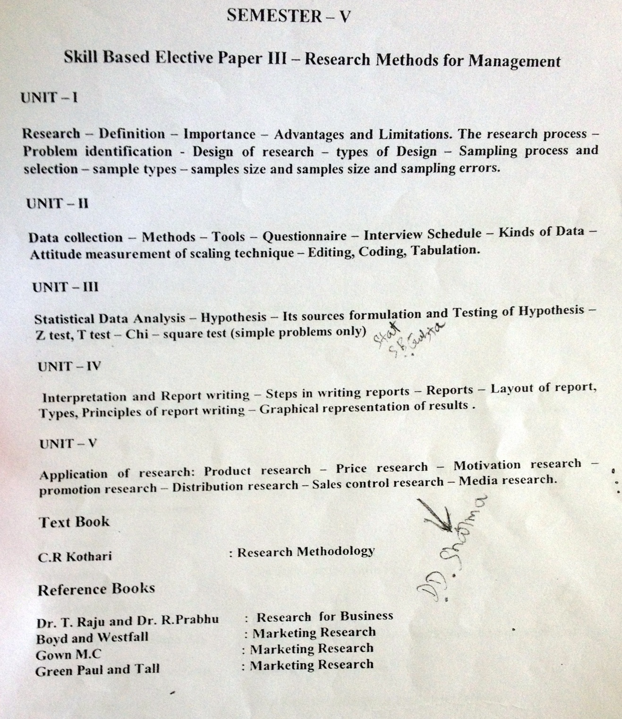

Slide 3
UNIT 1
Research
Food
Clothes
House
Consumer Goods
Travel
Medicine and Drugs
Power
Luxury etc etc………

Slide 4
Definition of Research
Best’s Definition:
“Systematic and objective analysis and recording of controlled observations that may lead to the development of generalizations, principles or thesis, resulting in prediction and possible ultimate control of events”.

Slide 5
What is Research?
Research is a systematic or scientific investigation
to search for solutions to the existing and future problems
to establish relationship, if any, among variables and
to find something new to increase our knowledge

Slide 6
Searching for solutions to problems - Examples
A medical scientist researching to invent/ discover a medicine to cure cancer. Here cancer is the problem and the new medicine is the solution
A horticulturist engaging in research to find a suitable chemical/method to improve the colour of the apple. In this case dull colour is the problem and the new chemical/method is the solution.
A design engineer in a car manufacturing company trying to modify the engine to reduce fuel consumption. Here, the problem is higher consumption of fuel and the solution is new engine design.
The marketing team looking out for a new promotional programme to improve sales :
Problem: Poor sales
Solution: New promotional programme
The personnel manager in a star hotel searching for appropriate incentives
Problem: Lack of motivation or low morale
Solution: Appropriate incentive
A financial analyst searching for a simple way of calculating VAT
Problem: Complex way of calculating VAT
Solution: A simple procedure of calculating VAT

Slide 7
Establishing relationship among variables - Examples
Medical research undertaken to find out weather there is any true relationship between pawn-chewing and mouth cancer, sweet eating and diabetes or mental worries and baldness.
Tea research station searching for correlations between shade pattern and yield of tea, sunshine and quality of tea or rainfall and fungal diseases
Marketing wings investigating the association between disposable income of middle income group and sales of four-wheelers or educational background of housewives and demand for white goods.
Production departments analyzing the relationship between preventive maintenance and productivity, raw materials and product quality or training programmes and industrial accidents.
HRD managers conducting surveys to find plausible association between absenteeism and supervisor’s attitude, incentives and overtime work or frequency of strikes and grievances handing mechanism.

Slide 8
Researching to increase knowledge - Examples
A clinical psychologist intensely observing how a HIV-positive person behaves in a group to add more information to group therapy
An agricultural scientist conducting a botanical survey to improve knowledge on plant diversity
Govt.of India sending teams of scientists to Antarctica to explore the possibility of any biological growth in freezing environment
Discovery channel deploying animal enthusiasts in African jungles to add more knowledge to animal behavior.
A personnel manager observing through a hidden video camera the behavior of workers in the canteen to improve his knowledge on off-the-job behavior of workers
A marketing researcher posting himself in a corner of a departmental store to understand more about customer behaviors in customer relationship management

Slide 9
Why to Study Research Methodology?
A study of research methodology helps people:
to be aware of the range of research methods that can be employed.
to make appropriate choices [i.e to understand whether to employ a particular technique of data collection or analysis.
to know the ‘dos’ and ‘don’ts’ when using a particular approach to collecting or analyzing data.
to provide insights into the overall research process.
to differentiate good research from bad research and
to transfer the learnt skills such as sampling, designing questionnaire, conducting interview, making observations etc to other areas.

Slide 10
Objectives/Purposes of Research
to gain familiarity with a phenomenon ( buying behavior of rural population in respect of latest electronic gadgets)
to analyze the characteristics of an individual, group or situation ( understanding the leadership skills of a successful business magnate, the phenomenal expansion of a new company or the reasons for delinquency in low-income groups)
to determine the frequency of occurrence of certain phenomenon ( fatal accidents in highways and railway crossings and alcoholisms/ absenteeism among workers)
to test a causal relationship between variables ( different age groups and their visits to beauty parlors or excess pocket money and student’s absenteeism )
to develop new techniques, concepts or theories ( new advertisements through animation or promotional campaigns involving physically challenged persons) and
to find solutions to problems ( this could be the ultimate objective)

Slide 11
Other Objectives
to identify facts for critical evaluation.
to develop new tools / techniques for studying unknown phenomena
to help planning and formulation of strategies and policies.
to promote better decision making
to aid in forecasting and

Slide 12
Characteristics of a Good Research/Researcher
The term RESEARCH itself carries the quality
of the good research. Further, the popular
term "MOVIE" supplements "RESEARCH" in
describing an ideal research

Slide 13
RESEARCH
R-Rational ways of thinking
E-Expert treatment
S-Search for solutions
E-Exhaustive treatment
A-Analytical (Analysis of data)
R-Relationship between facts and theories
C-Constructive attitude, critical observation, condensed generalization and cautious /
careful recording
H-Honesty and Hard work

Slide 14
MOVIE
M-Mathematical precision/accuracy
O-Objectivity
V-Verifiability
I-Impartiality
E-Exactness

Slide 15
Further a good research includes the following……..
Defining the purpose clearly.
Detailing the research process
Planning the research design
Revealing the limitations frankly
Maintaining high ethical standards.
Analyzing the decision marking need adequately
Presenting the findings without confusion
Justifying the conclusions

Slide 16
Criteria in Business Research
Reliability
Replicability
Validity

Slide 17
Limitations of Scientific Research in Business
Uncertainity
Unexplained principles
Difficulties in replication
Complex Human Behaviour
Controlling in Scientific method
Continued

Slide 18
Bias in Observation or Interpretation
Difficulties in measurement
Lack of actionable results
Inadequacy
Manager’s Apathy

Slide 19
Research Process
Research process is the methodology or well defined procedure of conducting a research.
it is a rigorous and impersonal mode of procedure dictated by the demands of logic and objectives.
it is systematic, logical, empirical and replicable
it involves various steps which are neither mutually exclusive nor are they separate or distinct.
in brief, research process is a scientific enquiry

Slide 20
Give diagram of research process – flow chat fig 1.2

Slide 21
Step 1: Defining the research problem:
It is the process of identifying and pin-pointing a specific problem which requires a detailed investigation

Slide 22
Step 2: Review of Literature
Review includes collection of facts, details on concepts/theories and importantly the findings of earlier investigations/researches relevant to the problem in the process.

Slide 23
Step 3: Formulating Hypotheses:
Hypothesis, which is a proposition, assumption or a tentative answer, is formulated to focus the research and to keep the researcher on the right track.
Hypotheses (null hypothesis or alternative hypothesis) are either accepted or rejected based on the significance of statistical results

Slide 24
Step 4: Research Design
Research design includes
Operational design : Collection of data from entire population (census) or a sample.
Sampling design: A definite plan for obtaining a sample from a given population
Observation design: Methods or tools such as interview schedule, questionnaire, personal / telephonic interview, participant/non-participant observations and etc. to collect information.
Statistical Design: Selection of appropriate statistical tests to analyse the data collected. The designs are flexible to accommodate the needs of various types of research

Slide 25
Step 5: Data Collection
Adequate and reliable data are collected employing appropriate technique –
observation, interview, questionnaire and etc.

Slide 26
Step 6: Data Processing and Analysis
Data processing includes editing, coding ( if necessary) and tabulation.
The tabulated data are analysed employing appropriate statistical tools (tests of significance).
Statistical analysis determines whether the effects, relationships or differences are significant or not. Hypotheses are either accepted or rejected based on statistical analysis

Slide 27
Step 7: Interpretation and Inference
` An interpretation demands a thorough subject knowledge, analytical ability and common sense. Inferences are drawn from the interpreted data. Inferences are the final findings of the investigations

Slide 28
Step8: Solution and Conclusion
Solutions are derived from interpretations/inferences. Solution is the answer to a problem in question.
Conclusions are arrived at based on the findings. It is generalization of the findings which is the essence of the whole study.
Fig 1.3: Flowchart of Research Process (Zikmund, 2009)
Fig 1.4: Steps in conducting a social survey (Bryman and Bell, 2010)

Slide 29
DEFINING RESEARCH PROBLEM
  Conditions for the existence of a problem
  There must be an organization, a group of people or an individual experiencing some difficulties due to one reason or other.
  (ii) There must be some objectives, personal or organizational, to be attained. If one does not desire anything there cannot be any problem.
  (iii) There must be at least two ways to attaining the objective; if there is only way, there is no confusion and hence no problem.

Slide 30
(iv) There must be some dilemma or confusion in selecting the best alternative to achieve objectives
(v) There must be an environment which influences either the researcher or his/her ways.
(vi) There must be some outcomes (results / findings) which may have positive or negative values

Slide 31
Problem identification and selection
1. Sources for identification of problems
a. Professional literature
b. Professional experience (self and others
c. Discussion with experts
d. inferences from theories and laws
e. General Sources

Slide 32
2. Justification for selecting a problem
a.Researcher’s suitability (Internal Criteria)
b.General Rule (External Criteria)

Slide 33
  Research Objectives
Research objective must be SMART ie, they must be
- Specific
- Measurable
- Achievable
- Realistic and
- Timely

Slide 34
  TYPES OF RESEARCH DESIGN
    Exploratory design
    It is an unstructured design to gain familiarity with an unknown population or phenomenon
to generate new ideas
to familiarize the researcher with the problem
to make a precise formulation of the problem (formulation of hypotheses)
to gather background information for clarifying a concept
to decide whether a particular study is feasible or not
to clarify and define the nature of a problem
to screen alternatives.
to expand the understanding of management dilemma.
to identify information that should be gathered to formulate investigative questions and
to find our sources for and actual sample frames that might be used in sampling design.

Slide 35
Examples of exploratory design
Space scientists exploring the possibility of existence of living organisms in other planets
Zoologists/ecologists observing the behaviour of wild animals at close quarters in African jungles for ‘Animal Planet’ channel
A marketing researcher feeling the pulse of rural population to explore the possibility of large scale retailing of micro-oven or computers

Slide 36
2. Descriptive Design
As the name suggests descriptive design describes an organization, industry, people, situation, phenomenon and etc.
Example:
To study the market share of a company’s product or services vis-à-vis that of the competitors to devise a strategic plan for further expansion.
To describe the dealers’ network of a company in respect of their size, turnover, products, infrastructure facilities, workforce and etc for effective management of company-dealers relationship
To observe the consumers’ behaviour towards a particular service for further refinement of the service

Slide 37
3. Diagnostic Design
Diagnostic design tries to find out the relationships, if any, among the various variables, dimensions or parameters.
It aims at identifying the causes of a problem to enable the researcher search for a solution
It helps in testing of hypotheses

Slide 38
Examples of Diagnostic design are
To study to reasons for the low/high market share of a particular product/service
To find out why the dealers’ interest in a particular product/company is on the decline.
To understand why the consumers behave in a particular way towards a particular service/product

Slide 39
    4. Analytical Design
This design is a part of diagnostic design.
It is presumed that analysis is a pre-requisite for diagnosis. In medical profession, the physician subjects the patient to a number of tests (analyses) such as measurement of blood pressure, blood/urine sugar, hemoglobin, cholesterol and etc. for diagnosis of the ailment.

Slide 40
    5. Causal Research Method
    Known as explanatory research, causal research method is a design to identify cause-and-effect relationships among variables

Slide 41
    6. Experimental Design
Experiment is a research method in which conditions are controlled so that one or more variables can be manipulated to test a hypothesis.

Slide 42
Examples of Experimental design
A physician administering different medicines on groups of patients to find out the most curative medicine
An agricultural scientist applying various types of fertilizers in the field to choose the best fertilizer for improvement of yield of a crop

Slide 43
  Case study method
A case study is an in-depth and thorough
study of an organization, a group of people,
an industry, an individual or a phenomenon.

Slide 44
Sampling
In the sampling method instead of every unit
of the population, only a part of the
population is studied and conclusions are
based on the data/information collected from
that part of the population

Slide 45
Principles of sampling
There are two important principles which govern the theory of sampling
1. Principle of statistical regularity
2. Principle of ‘Inertia of large numbers’

Slide 46
1. Principle of statistical regularity
The law of statistical regularity states that ‘a moderately large number of items chosen at random from a large group, are almost sure on the average to possess the characteristics of the large group’.

Slide 47
2. Principle of ‘Inertia of large numbers’
It states that, other things being equal, larger the size of the sample, more accurate the results are likely to be.
This points out to the fact that conclusion drawn based on a larger sample is more reliable than that of a smaller sample.

Slide 48
Terms used in Sampling
Population: A population is the total collection of elements/units about which some inferences are drawn. It is also known as universes.
Finite population: If the number of elements/units in a population is limited and accessible to the researcher for data collection, it is known as a finite population (car manufacturers in a country, exclusive dealers of a popular brand of white goods, students in a class)

Slide 49
Infinite population: If the researcher has no definite idea of the total number of units of a population and accessibility to all the units is not easy for data collection it is an infinite population (TV viewers, bicycle owners, black money launderers, drug addicts, cell-phone users in a city, income tax evaders, customers of a departmental store or consumers of pizza)

Slide 50
Target population: It is part of the total population about which the study is concentrated (users of a particular network among the mobile phone owners, students with commerce degree among the MBA students, computer-savvy employees in an organization or post-graduates among the call-centre employees).
Subject: It is a single member of a sample as element in population.

Slide 51
Census: It is the study or collection of information/data from all the units/elements of a population.
Sample: A sample is the portion of the population which is supposed to truly represent the population. Some of the cancer-patients in the medical research, few of the mango trees in an orchard for the horticultural research, a group of customers of a store in the CRM study, a section of the students in a class in the teaching method study, a small number of bolts/nuts in the quality control research or a handful of rice grains from a bagful of rice constitute a sample.

Slide 52
Sampling: It is the process of selection of a sample (a part of the population) with a view to obtain information or draw inference about a population.

Slide 53
Sampling Technique/Design: It is the procedure adopted to select a sample (probability or non- probability)
Sampling frame: It is a list containing all sampling units from which the sample is to be drawn. In finding out the satisfaction level of customers of BSNL in Coimbatore, the Coimbatore Telephone Directory is the sampling frame. In studying the performance level of a particular brand of car the list of buyers maintained by the dealer is the sampling frame. For the study on income tax payers, the list of IT payers maintained at It office is the sampling frame

Slide 54
Sampling fraction: It is expressed as n/N where ‘n ’ is the sample size and ‘N’ is the population size.
Estimator: Any sample statistic that is used to estimate a population parameter is called an estimator. That is, an estimator is a sample statistic used to estimate a population parameter. Example: The sample mean can be a an estimator of the population mean µ.
Estimate: An estimate is a specific numerical value of the estimator. That is, an estimate is a specific observed value of a statistic.

Slide 55
Parameters vs. Statistics
A parameter is a characteristic of a population, whereas a statistic is a characteristic of a sample.
Parameters are characteristics which describe a population. Statistics are characteristics which describe a sample. Mean, Variance, S.D. and etc are the characteristics to describe a population or sample
show table 6.1 in chapter 6

Slide 56
Steps in the sampling process
These are a few sequential steps in taking samples.
Deciding the target population
Identifying the parameters of interest (mean, variance, proportion etc)
Selecting the sampling frame
Finalizing the appropriate sampling method
Fixing the sample size
Executing the sampling process

Slide 57
Sampling designs: (Sampling techniques or sampling methods)
The different types or methods of sampling are governed by two factors
Basis of representation: The sample may be a probability sample or a non-probability sample.
Technique of selection of units: The sampling may be either unrestricted or restricted.

Slide 58
Table of Sampling methods
The various sampling methods are shown in the following table
show Table 6.2 chapter 6

Slide 59
Probability Sampling
(i) Simple random sampling
This refers to the sampling technique in which each and every item of the population is given an equal chance of being included in the sample.
That is why, random sampling is sometimes refered to as ‘representative sampling’.

Slide 60
Methods of obtaining simple random samples
Lottery method:
Under this method all the elements of the population are numbered or named on separate slips of paper of identical size, colour and shape. These slips are folded and mixed up thoroughly in a container. From this a blind-fold selection is made of the number of slips required to constitute the desired size of the sample.

Slide 61
b. Using table of random numbers:
Tippett’s table of random numbers, Fisher and Yates numbers or Kendall and Balington Smith can be used.
c. Using computer:

Slide 62
ii.) Complex probability sampling
a.)Systematic sampling:
This method is used in those cases where a complete list of the population is available. This method involves selection of every kth item from the list where k refers to the sampling interval or skip interval.

Slide 63
b.)Stratified sampling:
In this method, the heterogeneous population is divided into smaller homogenous groups or strata and from each stratum, random sample is drawn.

Slide 64
c.) Cluster sampling:
In this technique the units of population are divided into a number of groups or clusters and each cluster will be considered as a sample unit. Thus the large numbers of units are reduced to manageable cluster.

Slide 65
d.) Multi-Stage Sampling:
As the name suggests this method refers to a sampling method which is carried out in several stages. The population is regarded as made up of a number of first stage sampling units, each of which is made of a number of second stage units and so on. At first, the first stage units are sampled by random sampling. Then a sample of second stage units is selected from each of the selected first stage units again by random sampling. Further stages may be added as required.

Slide 66
e.) Multiphase Sampling
Here a sample is drawn to collect some information which is convenient or economical. Based on the information a subsample is taken for further study.

Slide 67
Non- Probability Sampling a. Convenience Sampling:
Here, the sample is selected neither by probability nor by judgement but by convenience.
Researchers or field workers have the freedom to choose whomever or whatever they find and thus the name “convenience”.

Slide 68
b. Judgement sampling
In this method the population units getting into the sample depend exclusively on the judgement of the researcher.
Sometimes the researcher can take the opinion of experts in the field. In other words, the researcher exercises his judgement in the choice of sample units

Slide 69
c.) Quota Sampling
In a quota sample quotas (proportions) are set up and within each quota the sample units are selected according to the convenience or judgement of the researcher.

Slide 70
d. Snowball Sampling
It is a technique of ‘building up’ a list or a sample of a special population by using an initial set of sample units or members as indicators/informants

Slide 71
Probability vs Non-probability sampling
Show table 6.6 in chapter 6

Slide 72
  Sample Size
There is no fixed number of units or percentage of population that determines the optimum size of a sample.
The so called ‘thumb-rule’ of 10% of the population is not based on any scientific proof.

Slide 73
Determinants of sample size
The size of the sample depends on many factors.
Nature of the population
Nature of the study/objective
Type of sampling
Level of accuracy
Confidence level
Availability of target population
Type of measuring techniques
Time
Availability of resources
Kind of analysis

Slide 74
Sampling error
It is the standard error in sampling contexts. It is also known as random sampling error.
It is a statistical fluctuation that occurs because of chance variation in the elements selected for a sample.

Slide 75
Sampling errors arise
if the sampling is done by a non –random method
if the sampling frame is incomplete or inaccurate
if some sections of the population are not available/refuse to co-operate
if the sample size is too small

